Slide 1

The Puppet Show

Slide 2

The problem
Let's say we have a bunch of servers
Custom scripts to administer them
Touching config files manually
Duplication of work even in servers with same Operating System / same services
No history of the changes
Hard to communicate between sysadmins
Impossible to review changes
Impossible to automate testing/QA

Slide 3
The solution
A central storage place for all the configs
Easy and secure distribution of the configs along the servers
Categorize the servers / services
Conditions of the installed configs per server / service
History, revisions, diff ...
Handle misc files, users, cronjobs, runlevels etc
Support different operating systems

Slide 4
What is Puppet
Central Configuration management system
IT automation software
… and it supports every dot of the previous slide :)
Open Source, Written in Ruby
Has its own simple declarative language
Manifests, modules
Custom data types in ruby
Text files (filebucket), smoke tests, templates

Slide 5
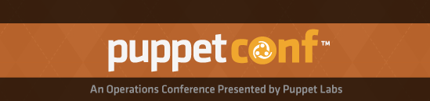

What is Puppet
Community oriented
  Puppetdashboard / Puppet forge
  IRC / mailing lists
  Puppet Camp / PuppetConf / Puppet User Groups & Devops Groups
Puppet Enterprise
PuppetLabs

Slide 6
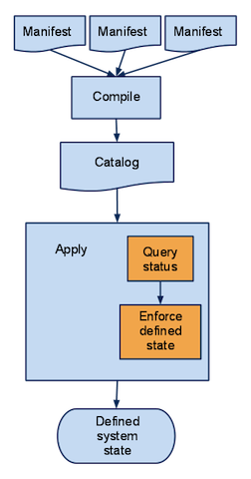
Process

Slide 7
Let's write some code!
Example: Puppetmaster distributes a simple manifest to several agents, running different OS
Then we are going to write a few simple manifests
You need puppet installed in your system

